Slide 1
Performance Evaluation of Machine Learning and Convolutional Neural Network Based Skin Lesion Classification Techniques Using Dermatoscopic Images
Course: ECE 740 A02 (Advanced Topics in Signal and Image Processing)
Term: Fall 2024
Presented by-
Md Touhidul Haque

Slide 2
Motivation
Skin Cancer
One of the three most-dangerous and -rapidly expanding cancer types
One out of every three cancer diagnoses is related to skin cancer
According to WHO
Nearly 9,500 people in the US are diagnosed with skin cancer every day
According to AAD
Nearly 20 Americans die from melanoma every day
ML and Deep Learning based skin lesion diagnostic techniques are showing promising results
Evaluate their performance in multi-class skin lesion classification
Our project focus!

Slide 3
Proposed Work
Primarily based on the methodology presented by-
B. Shetty, R. Fernandes, A. P. Rodrigues, R. Chengoden, S. Bhattacharya, and K. Lakshmanna, “Skin lesion classification of dermoscopic images using machine learning and convolutional neural network,” Scientific Reports, vol. 12, no. 1, p. 18134, 2022
We aim to-
Design, train, and evaluate a customized CNN-based multi-class skin lesion classification technique as outlined in the reference paper.
Design, train, and test three classical ML models (DT, RF, and SVM) as baseline approaches for the multi-class skin lesion classification task.
Perform a comparative analysis of the performance between the CNN-based technique and the ML-based models.
Critically review the reference paper, highlighting its strong and weak aspects.

Slide 4
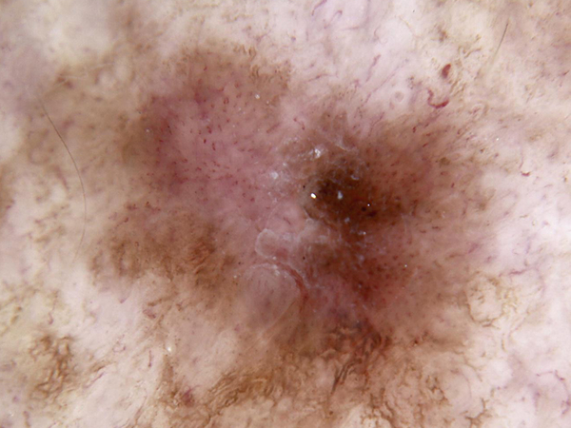
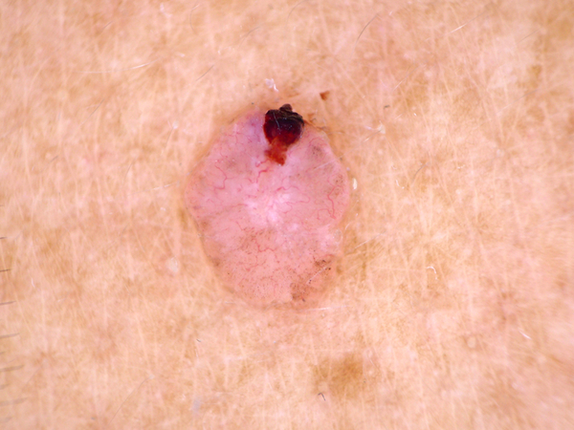
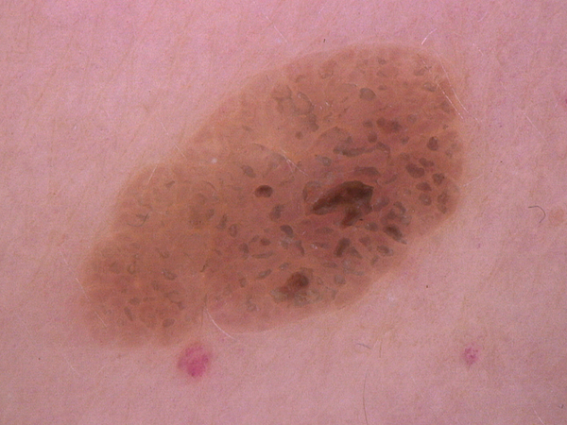
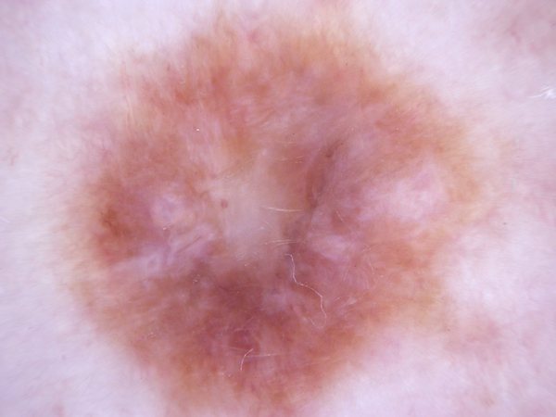
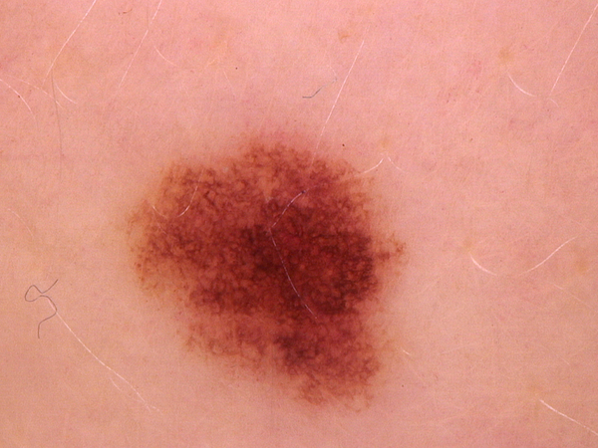
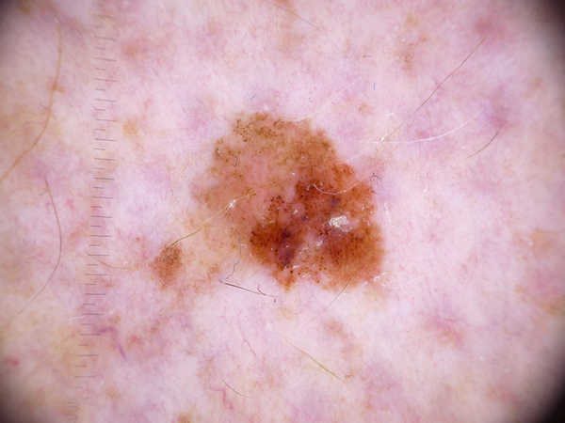
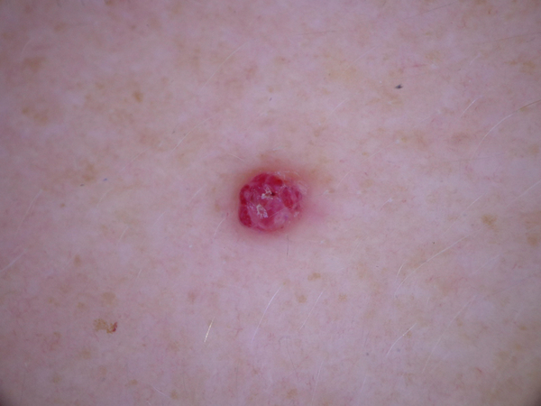
Dataset
HAM10000 - A collection of 10,015 dermatoscopic images of pigmented skin lesions across seven categories
Published in Nature’s Scientific Data in 2018
Harvard Dataverse Repository (Open Access)
1. Actinic Keratoses
2. Basal Cell Carcinoma
3. Benign Keratosis
Dataset is highly imbalanced!
Dermatofibroma --- 115 images
Melanocytic Nevi --- 6705 images
4. Dermatofibroma
5. Melanocytic Nevi
6. Melanoma
7. Vascular Lesions

Slide 5
Dataset
1. Actinic Keratoses
2. Basal Cell Carcinoma
3. Benign Keratosis
HAM10000 - A collection of 10,015 dermatoscopic images of pigmented skin lesions across seven categories
4. Dermatofibroma
5. Melanocytic Nevi
6. Melanoma
To address the class imbalance-
7. Vascular Lesions
1) Balanced Dataset-A (ML models):
Created by selecting 100 images per class (700 images total)
Applied data augmentation (horizontal flips) to generate 200 images per class
Final dataset: 1,400 images
2) Balanced Dataset-B (CNN model):
Deep learning models require large dataset for proper training
Applied augmentation techniques (horizontal flips, rotations, shearing, contrast/saturation/hue adjustments, & Gaussian noise) to generate 2000 images per class (except for class Melanocytic Nevi )
Final dataset: 14,000 images

Slide 6
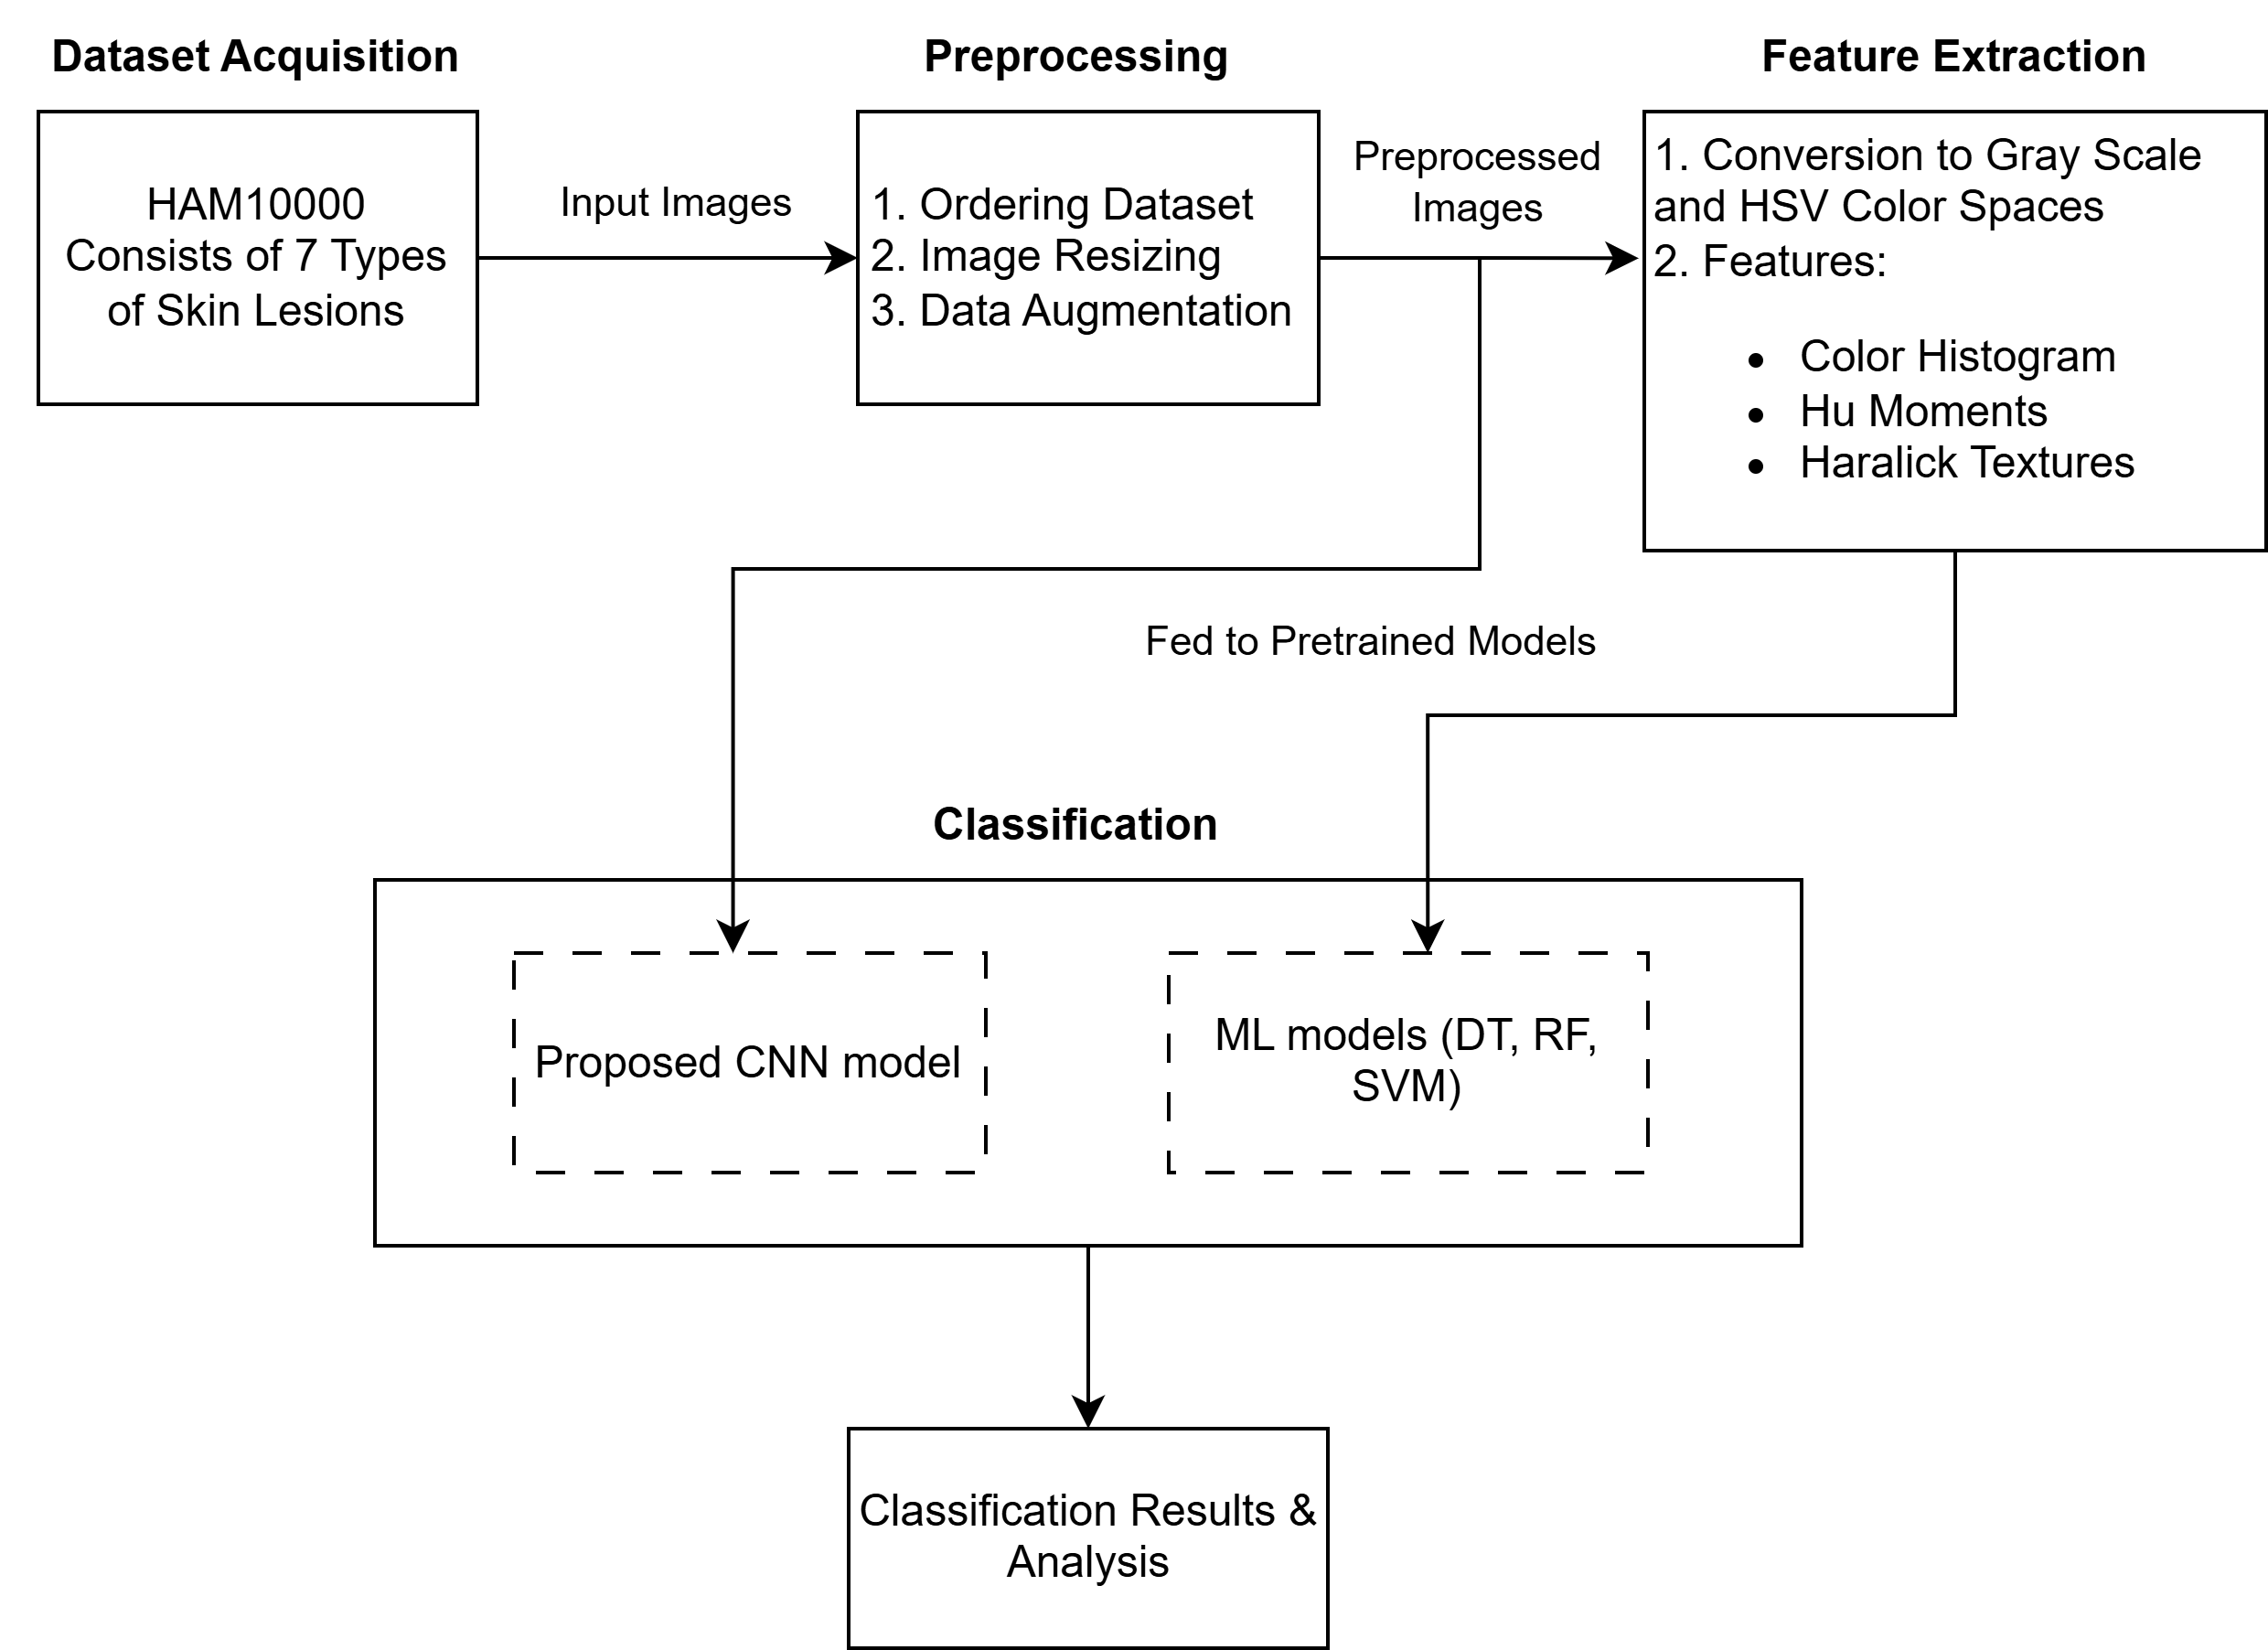
Methodology
Performance Indices:
Accuracy, Precision, Recall, and F1-score

Slide 7
Methodology
Preprocessing
1) Dataset Organization
Images categorized using lesion ID and diagnostic labels for analysis
2) Image Resizing
220×220 pixels for ML models
96×96 pixels for CNN model
3) Pixel Normalization
Pixel values normalized to 0–1
Class labels one-hot encoded for multi-class classification
4) Data Augmentation
Horizontal flips, random rotations, shearing, contrast/saturation/hue adjustments, & Gaussian noise to address class imbalance

Slide 8
Methodology
Feature Extraction (Only for ML models)
1) Conversion
Images converted to HSV color space and gray-scale format for handcrafted feature extraction
2) Features:
Color: HSV histogram (32 bins/channel). F_{color} = 32,768
Shape: 7 invariant Hu moments. F_{shape} = 7
Texture: 6 Haralick texture properties averaged across 4 directions. F_{texture} = 6
Feature Vector: F = { F_{color} , F_{shape} , F_{texture} }
Total size: 32,781 features

Slide 9
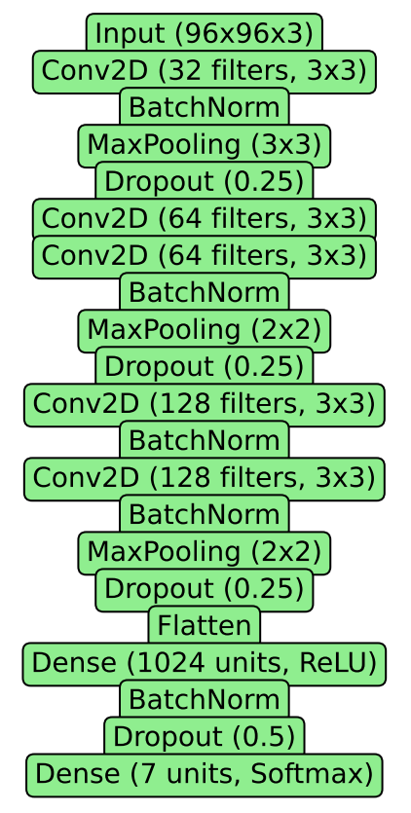
Methodology
Customized CNN model

Slide 10
Methodology
Customized CNN model
Three sets of convolutional layers with increasing filter counts: 32, 64, and 128 filters, each using 3×3 kernels.
Each convolutional layer followed by batch normalization, max pooling, and dropout regularization.

Slide 11
Methodology
Customized CNN model
Converts the feature map into a one-dimensional vector

Slide 12
Methodology
Customized CNN model
A Dense layer with 1024 units using ReLU activation
A final Dense layer with 7 units and Softmax activation for classification into 7 skin lesion classes.

Slide 13
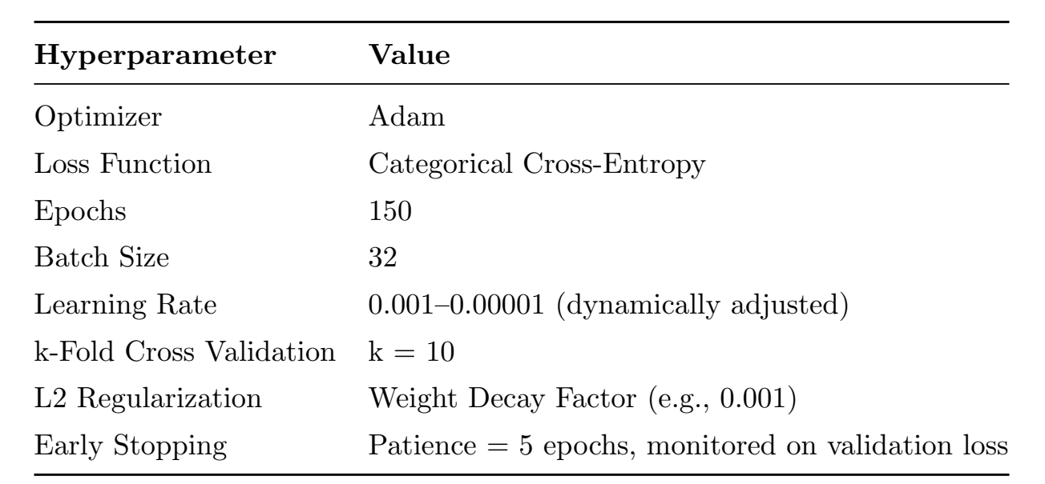
Methodology
Customized CNN model

Slide 14
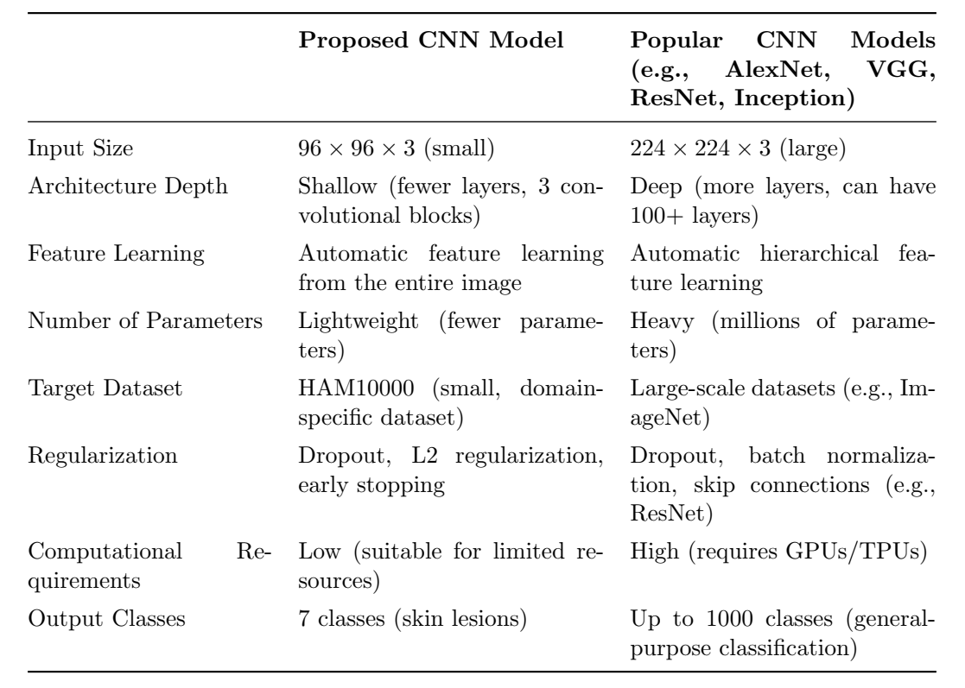
Methodology
Customized CNN model
Comparison with popular CNN models

Slide 15
Results and Analysis
Each balanced dataset split into training and testing test (80-20 ratio).
Due to data augmentation in the balanced dataset, there may exist some degree of similarity between an image and its augmented version.
There is a possibility of overestimation of the ML and CNN model performance!
Beside this testing set, we also used a new unseen test dataset (Provided in HAM10000 dataset repository) to measure a more realistic performance of the models.

Slide 16
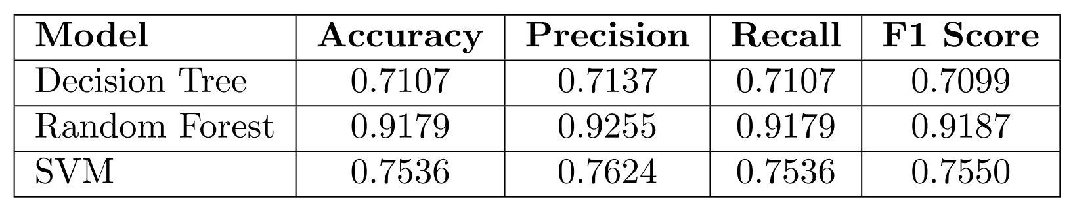
Results and Analysis
Evaluation of ML models:
Performance metrics using the testing set of balanced dataset
Random Forest
Ability to manage feature variability through ensemble learning
Similar results as the reference paper!

Slide 17
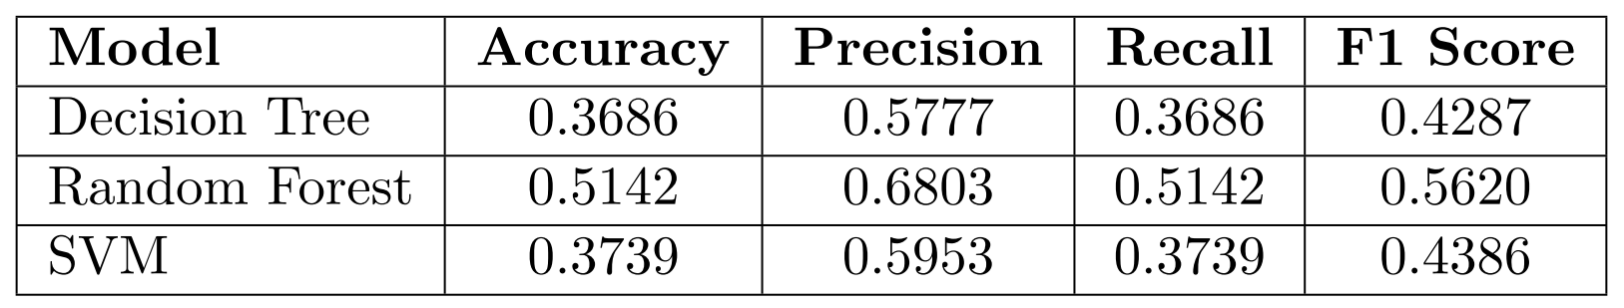
Results and Analysis
Evaluation of ML models:
Performance metrics using the testing set of balanced dataset
Performance metrics using the new unseen testing set
Possible reason: Data Leakage !

Slide 18
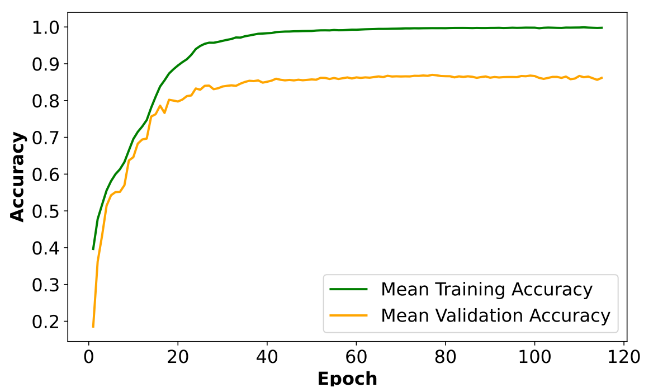
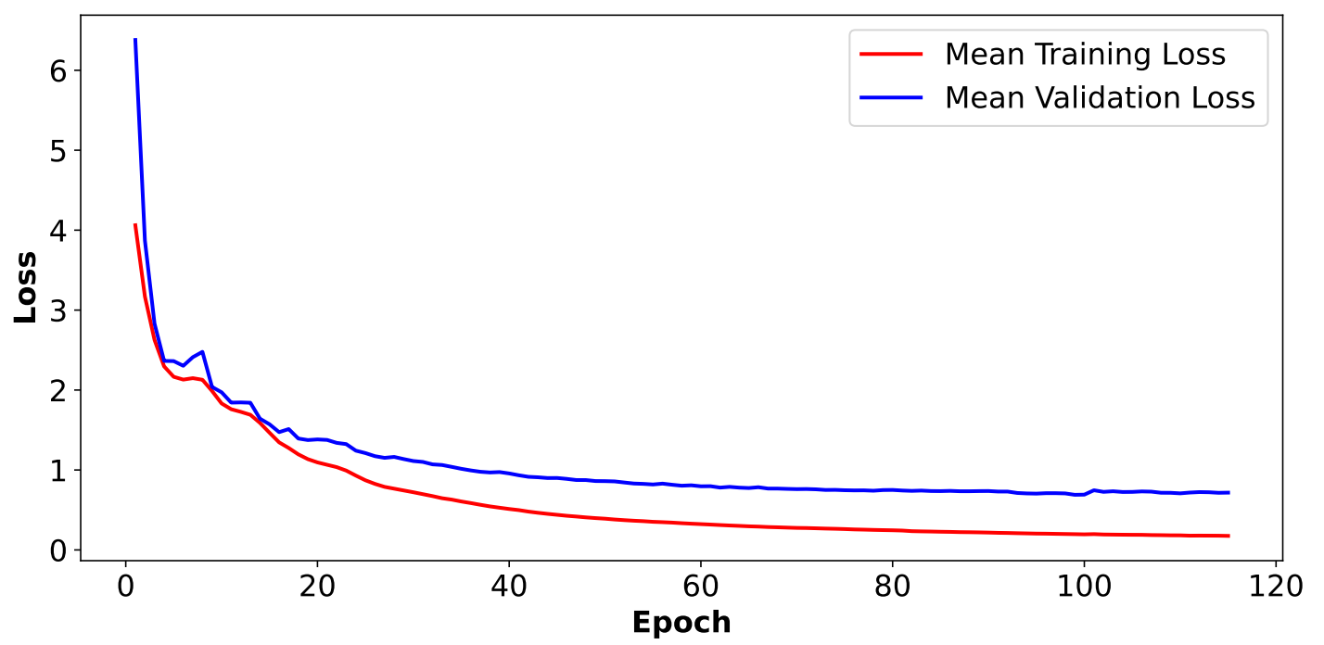
Results and Analysis
Evaluation of CNN model:
Averaged across all folds
Training accuracy reached approx. 98% whereas validation accuracy stabilized at around 86%.

Slide 19
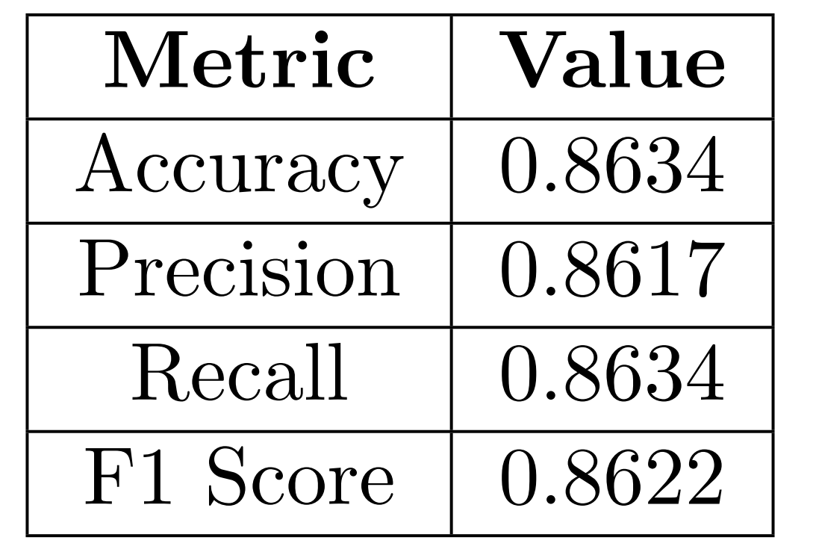
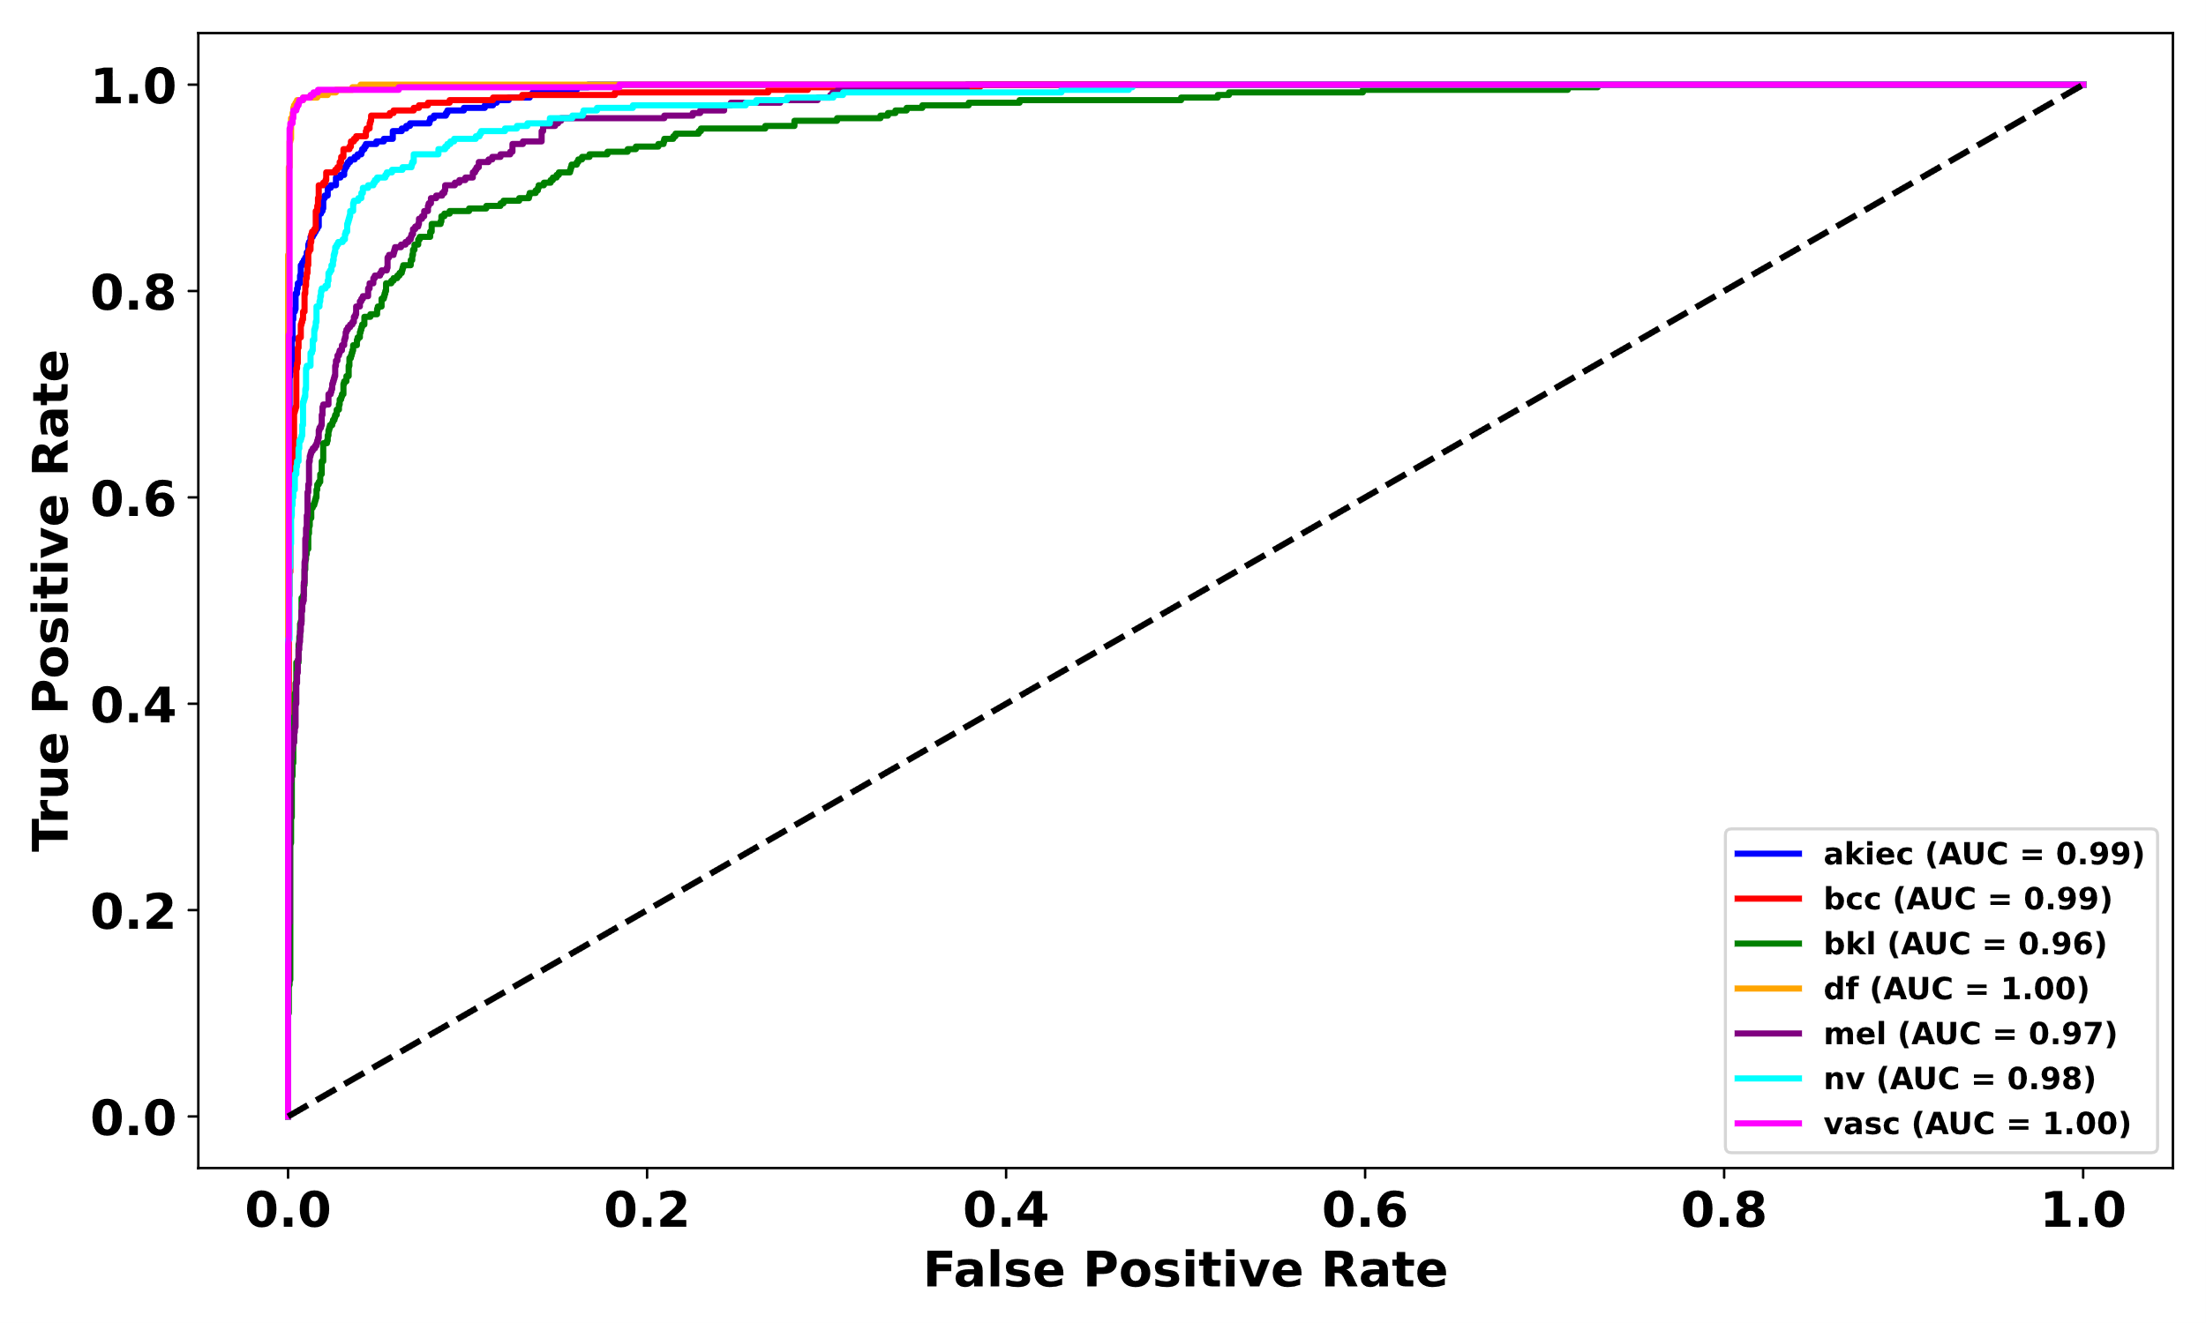
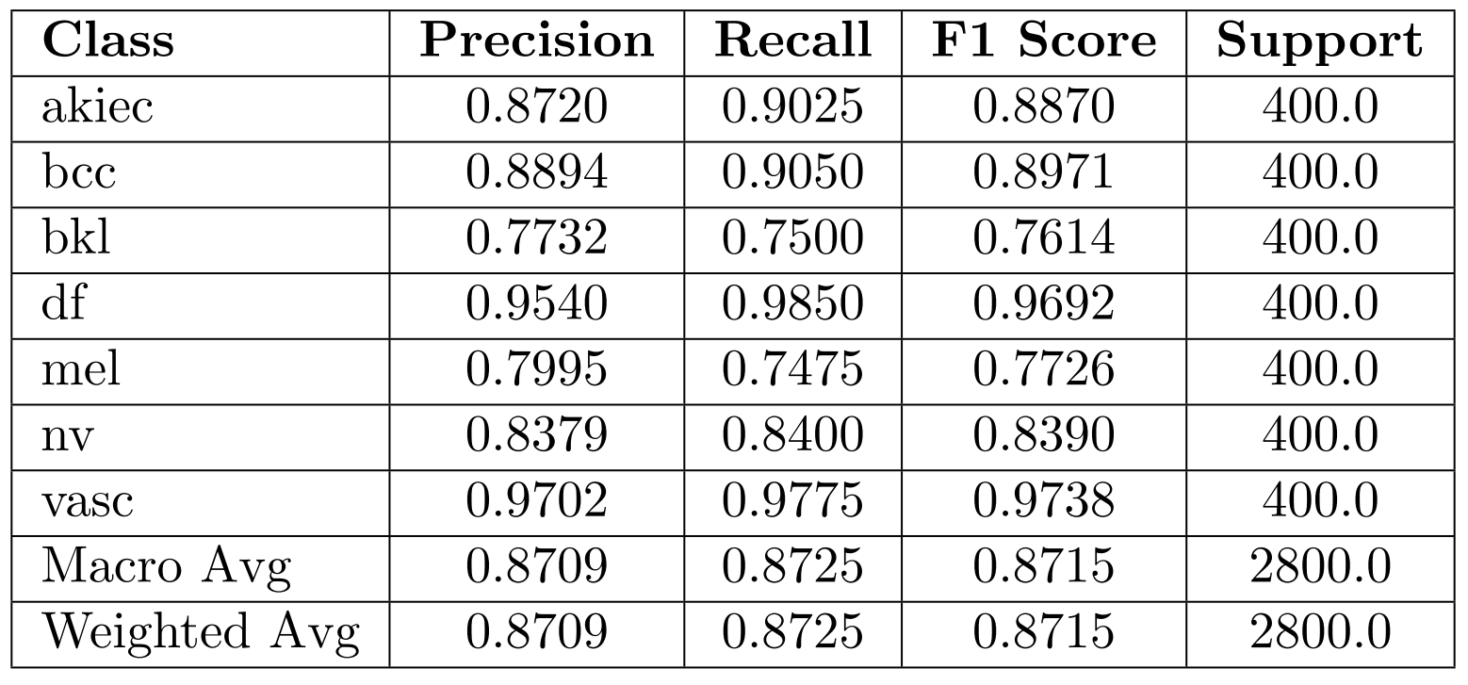
Results and Analysis
Evaluation of CNN model:
Performance metrics using the testing set of balanced dataset
Averaged across all folds
ROC curves for individual classes
Individual class performance
Similar results as the reference paper!

Slide 20
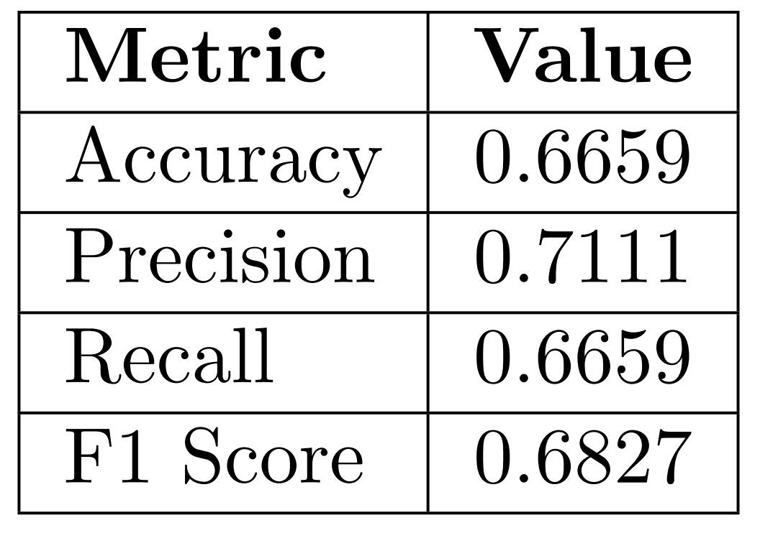
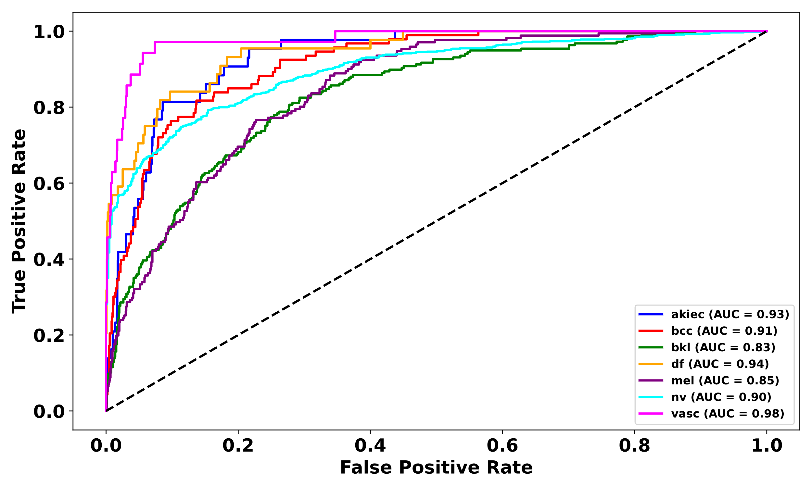
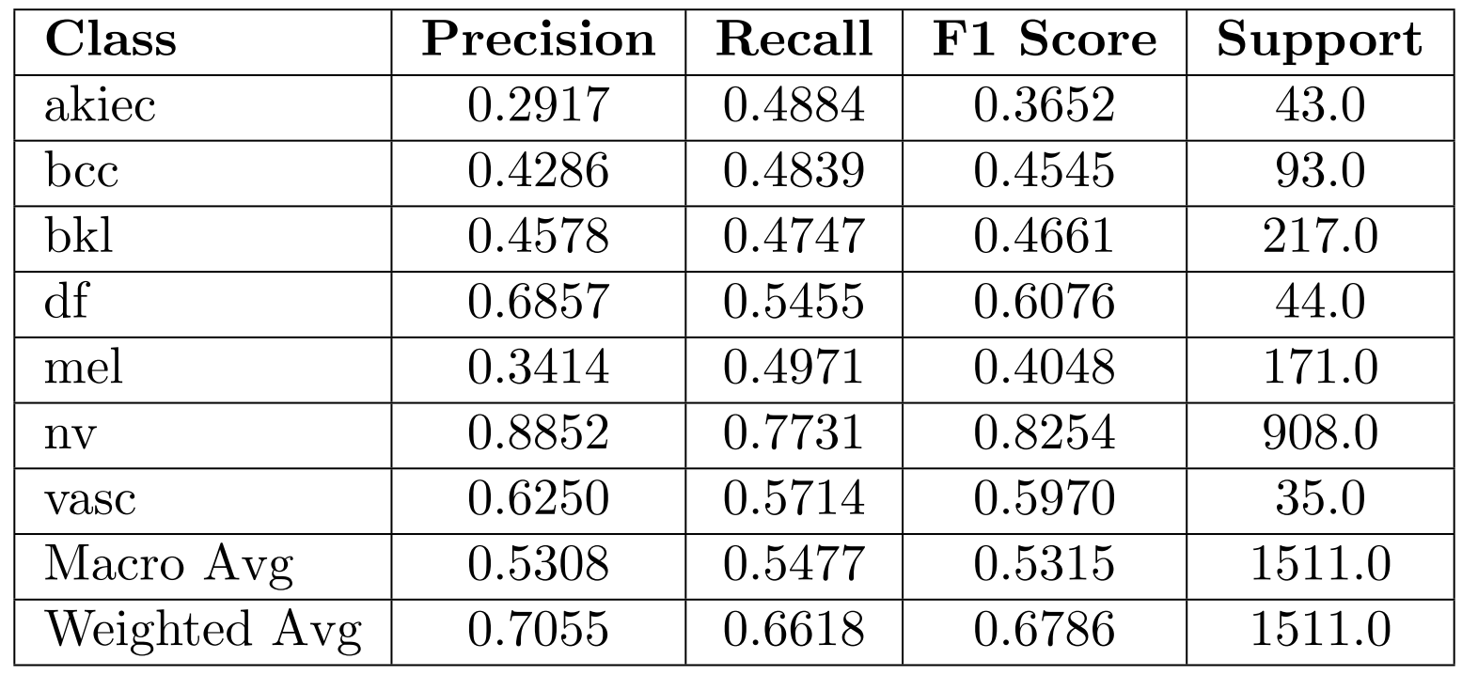
Results and Analysis
Evaluation of CNN model:
Performance metrics using the new unseen testing set
Averaged across all folds
ROC curves for individual classes
Individual class performance
Overestimation of the CNN model performance!

Slide 21
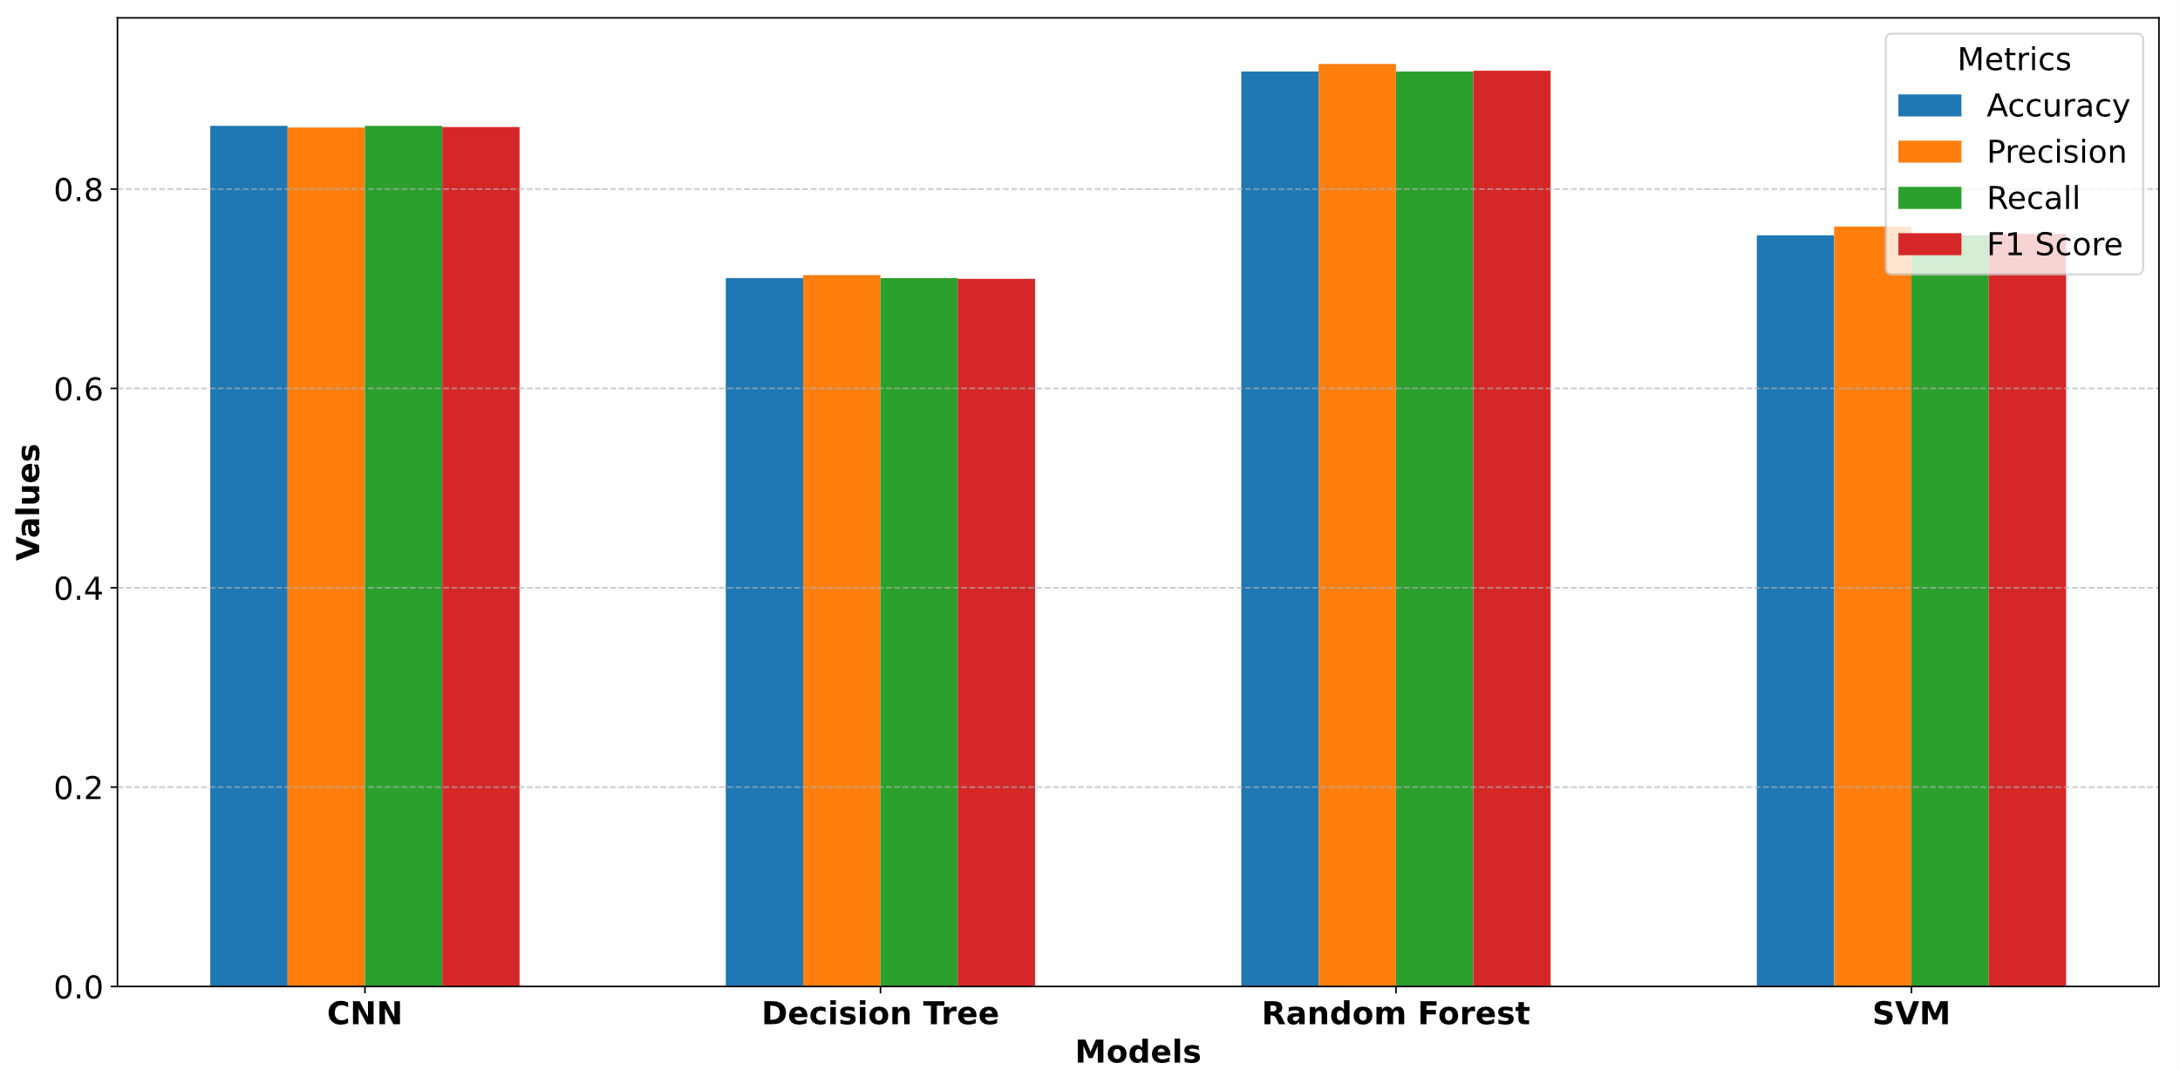
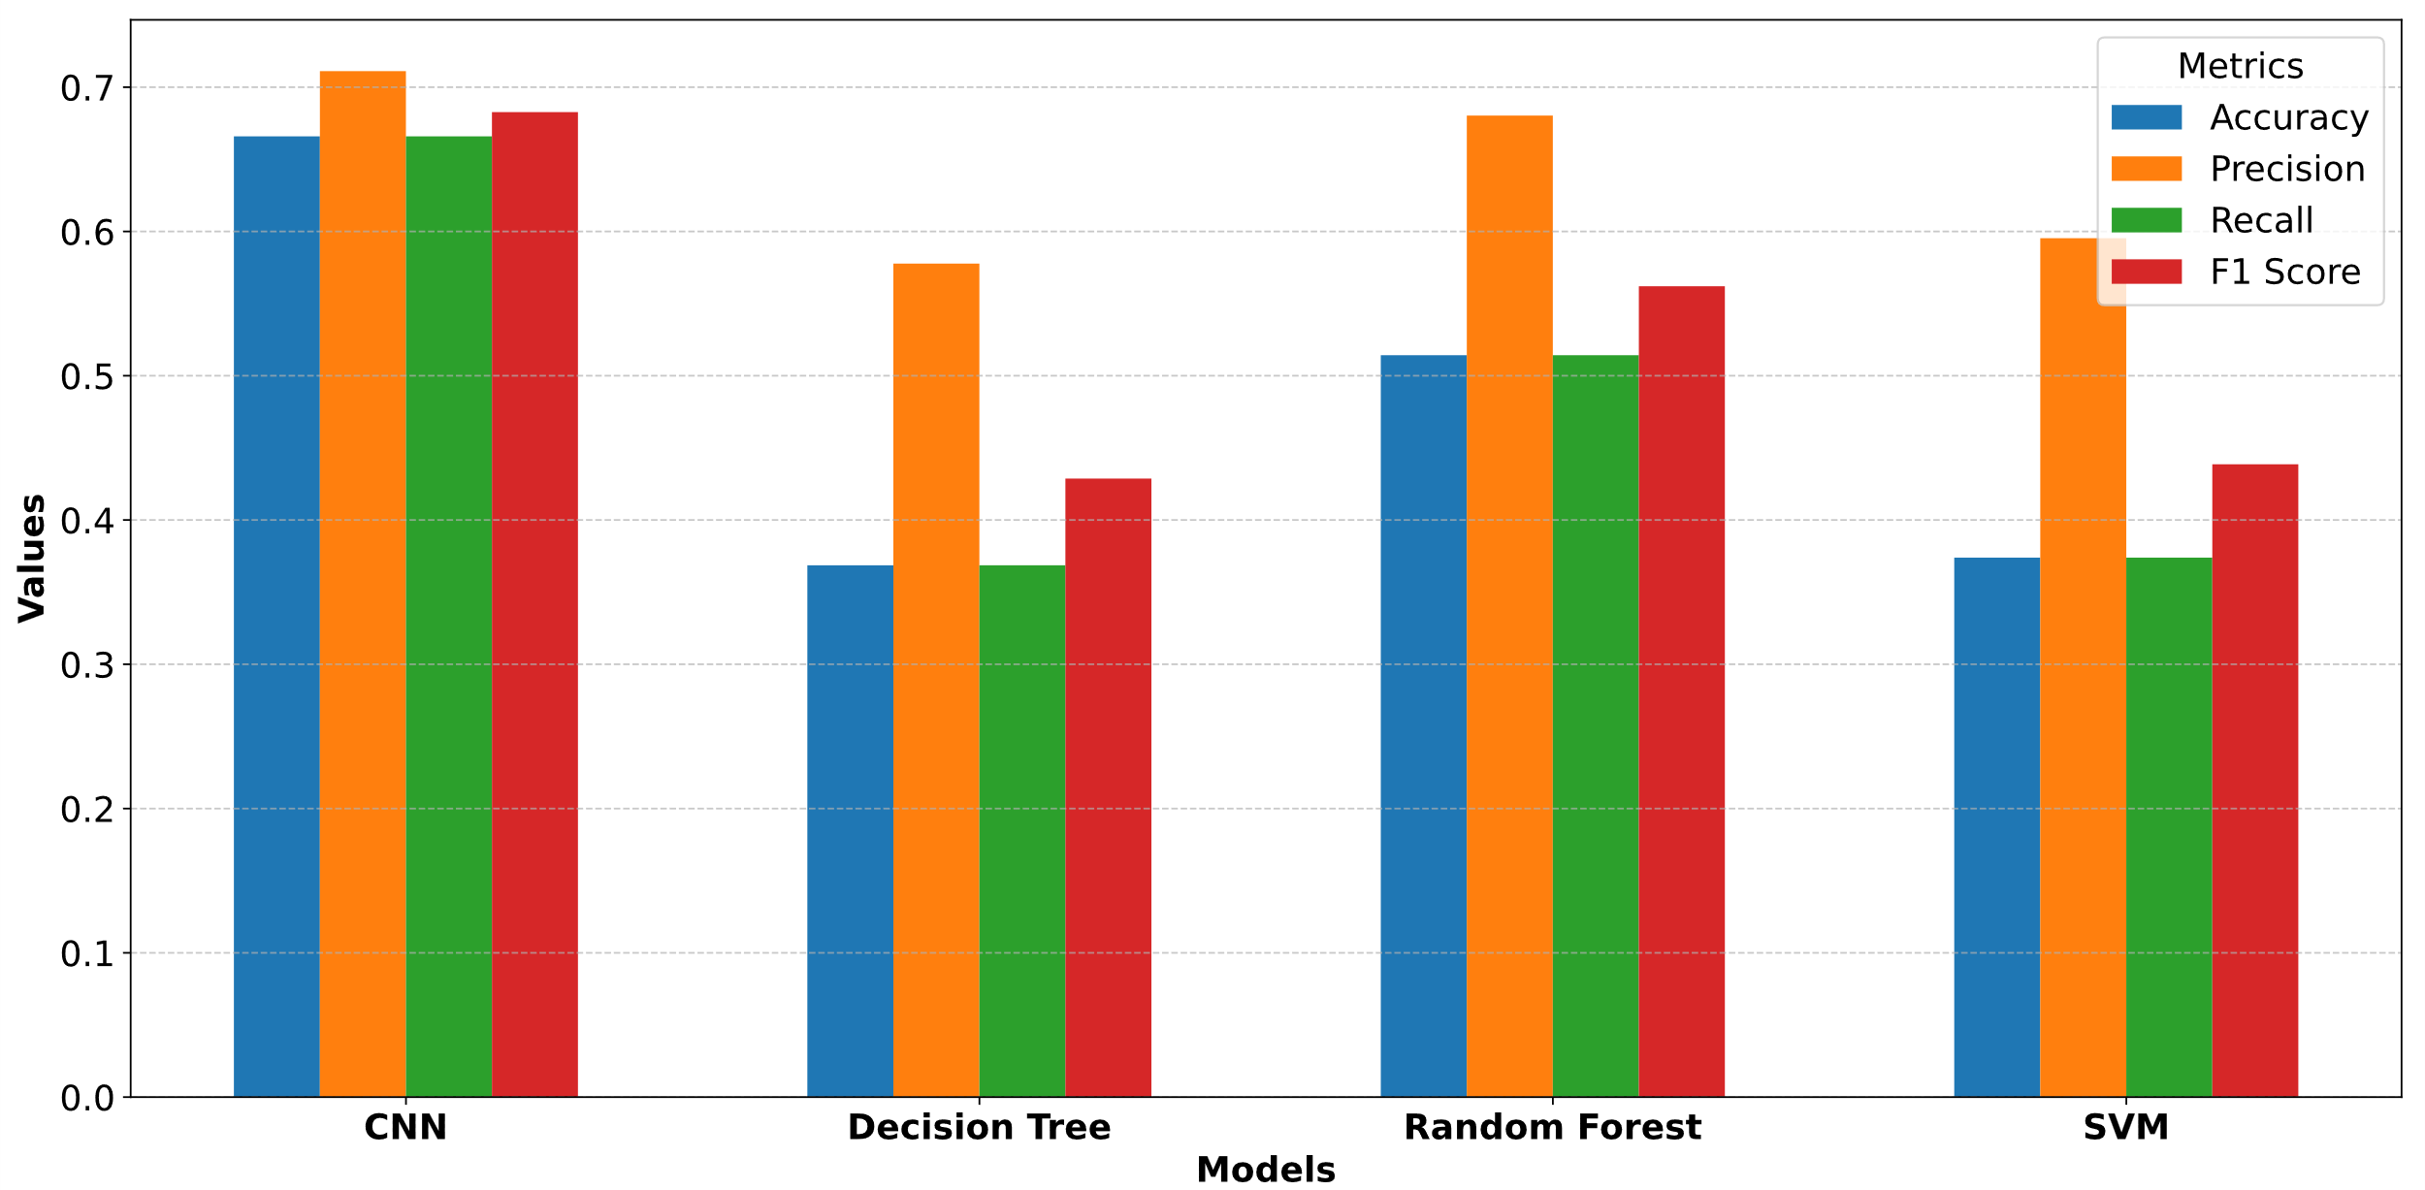
Results and Analysis
Comparison between the CNN and ML models:
Performance on testing set of balanced dataset
Performance on new unseen testing set
CNN outperforms the ML models on new unseen dataset!

Slide 22
Results and Analysis
Key Insights on the Reference Paper:
Strong Aspects:
Customized CNN Model
Outperforms classical ML models with minimal preprocessing and without the need for manual “feature engineering” by experts.
Fewer convolutional layers compared to popular CNNs, making it computationally efficient.
Weak Aspects:
Possible data leakage due to augmentation before splitting the dataset leads to overestimated performance of the CNN model.
Reporting training accuracy (e.g., 95.18%) as the primary metric could be misleading; realistic accuracy on unseen data is significantly lower (66.50%).
Accuracy and weighted average of recall should be equal; observed inconsistencies remain unexplained.

Slide 23
Thank You!
Any Question?

